Slide 1
Data Visualization with Tableau – Hands on workshop
Praneeth Vasarla,
Data Scientist,
Trice COMMUNITY TECHNOLOGIES Pvt. Ltd.,
Hyderabad.

Slide 2
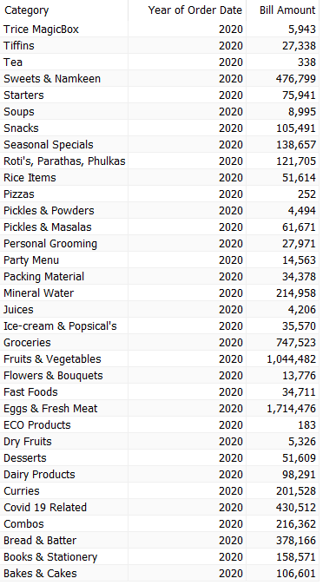
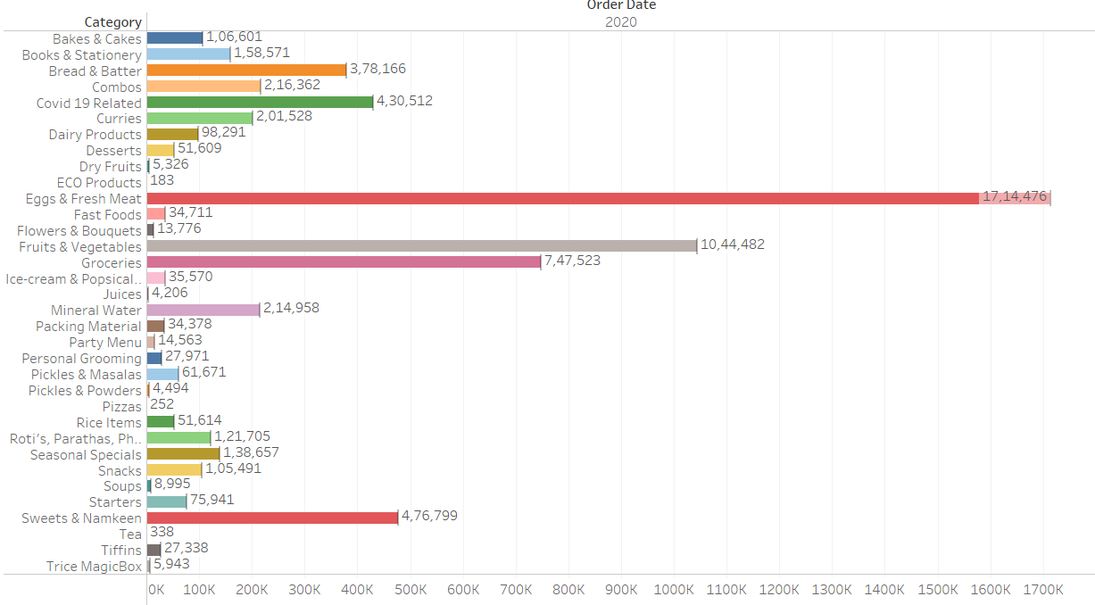
What is Data visualization anyways?
It’s the graphical representation of information and data! Simple, right?

Slide 3
Why does data visualization matter?
Decision Making should be better
Storytelling should be meaningful
Make data easier to understand and remember
Discover unknown facts, outliers, and trends
Visualize relationships and patterns quickly
Ask better questions and make better decisions

Slide 4

What is tableau?
Tableau is business intelligence software that allows anyone to connect to data in a few clicks, then visualize and create interactive, sharable dashboards

Slide 5





Other BI tools

Slide 6
So why Tableau?
Quick and Interactive Visualizations
Easy to Use
Handles Copious Amounts of Data
Mobile Friendly Dashboard
Integrates with Scripting Languages

Slide 7
Setting up Tableau
Tableau offers 1 year free professional license to students.
Visit https://www.tableau.com/academic/students
Enter the details.
You need your college ID card image to verify yourself

Slide 8
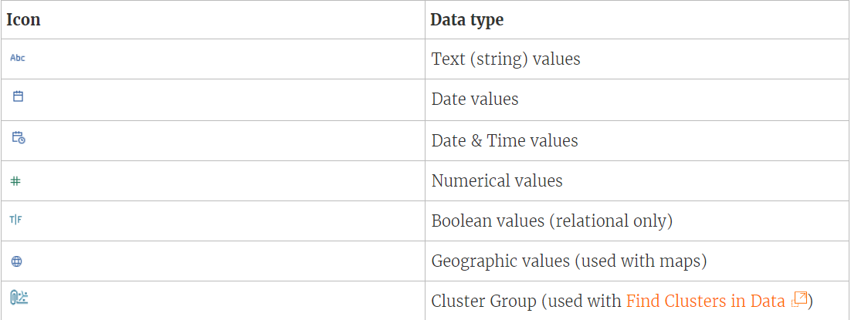
Data Types in Tableau

Slide 9
Hierarchies, Groups and sets
Hierarchies are a logical arrangement of relevant unique attributes in a data set.
Grouping in Tableau is grouping multiple members in a SINGLE dimension into a higher category
Sets are custom fields that define a subset of data based on some conditions.

Slide 10
Clustering and forecasting
Clustering is the task of dividing the population or data points into a number of groups such that data points in the same groups are more similar to other data points in the same group than those in other groups
Forecasting is the process of making predictions of the future based on past and present data and most commonly by analysis of trends.

Slide 11

Analysing the IPL Dataset!
We will now work with the IPL dataset and try to explore different charts and graphs in tableau through this dataset.

Slide 12
Asking the questions
How many matches did each team win?
What is the most chosen option after winning the toss?
Which team won the toss most times?
Team wise Toss decision analysis?
How many matches were played in each city?
What are favourable venues for each team upon batting/bowling first?
Where did each team win most matches?
How many times did each team win while setting target/ chasing target?
Who won most man of the match awards?
In which cities did the D/L method applied most times?
What is the average 1st innings score and second innings score in each venue?
Individual team’s performance since the beginning of IPL?
Distribution of 1st innings score throughout the IPL
Distribution of winning margin (in terms of runs and wickets) through out the IPL
Batsman wise runs scored in each season

Slide 13
Asking the questions
Batsman batting average
Orange cap winners each season

Slide 14
Sample Superstore dataset to explore groups, clustering and forecasting

Slide 15
Thank You!
You can get in touch with me via:
Email: praneethvaasarla@gmail.com
WhatsApp : 9490544108
LinkedIn: Praneeth Vasarla

